Slide 1
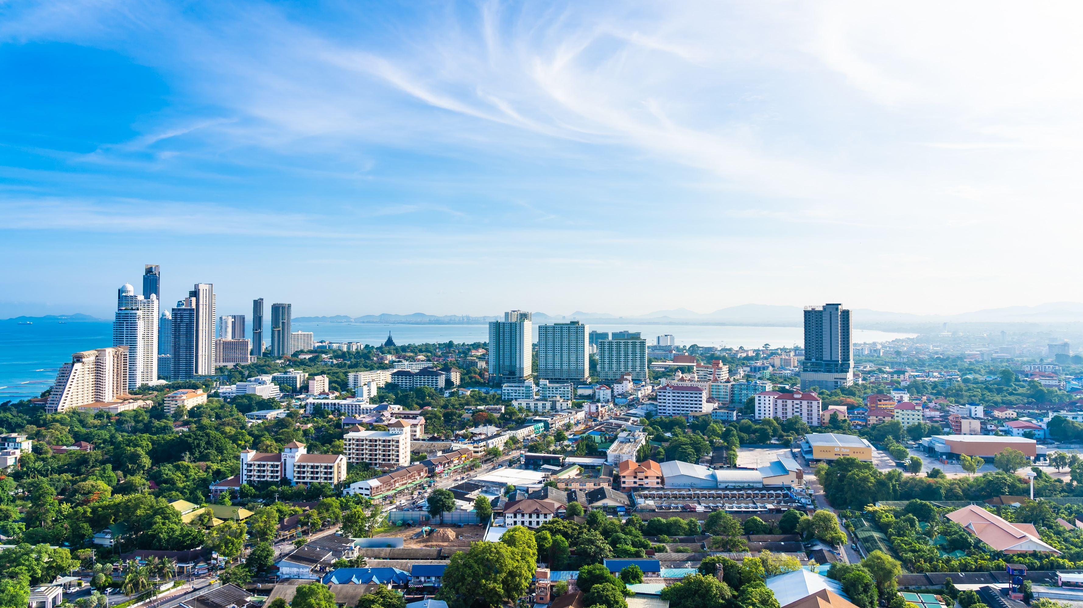
Leisure Diary
Leisure Diary
Hassle free all-in-one traveler
Name: Mohamed Fariq Abdulla Sabith
ID Number: E026503 | Batch 07
University ID: K2282910
Supervisor: Prof. Ruvan Abeysekara

Slide 2
Outline
Introduction
Background and motivation
Problem in brief
Aims & Objectives
Proposed solution
Design of the application
Methodology
Technologies and resources
Conclusion
Leisure Diary

Slide 3
Introduction
“Leisure Diary” is a proposed solution provided by the Afadamad (Pvt) Ltd who is a travel agent provides inbound and outbound travel services. The company has a huge network of hotels, resorts, other leisure activities, and related services in their chain.
The project is to provide a hassle free solution to travelers and service providers.
Leisure Diary

Slide 4
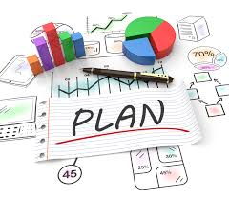
Background and Motivation
People are hassling in their day to day life and choosing to go on a trip to relax their minds. Planning and organizing process in a trip could be a complex task depends on the elements and people connected with that.
The primary Motivation of this application is to make the planning and organizing, a hassle free for travelers and to help related businesses to promote themselves and expand their business.
Leisure Diary

Slide 5
Problems
Drafting a plan could be a difficult task based on the elements or the components related to it. There are many elements to consider when drafting a plan such as no. of people, their interests, place, type of food, transport, other leisure activities etc.
Lack of information about the places when creating a plan(Activities).
Interlink their services with other services and to promote their services to clients.
Leisure Diary

Slide 6

AIM
To develop an all-in-one mobile application and a platform to plan, organize and execute a hassle-free trip to all the travelers’ and other related stakeholders.
OBJECTIVES
To identify and provide all in one solution for travelers to address all their needs through one application.
To suggest recommendations for travelers to get decisions when planning a trip.
To design a platform to other related stakeholders to promote their business.
To build a communication and interaction method between travelers and service providers.
Leisure Diary

Slide 7

Proposed solution
All-in-One hassle free Mobile application to fulfil travelers and service providers need.
Travelers to make request from service providers and get the confirmation through the application.
Service providers can post their services and other details in to the application through the dashboards provided to them.
Leisure Diary

Slide 8



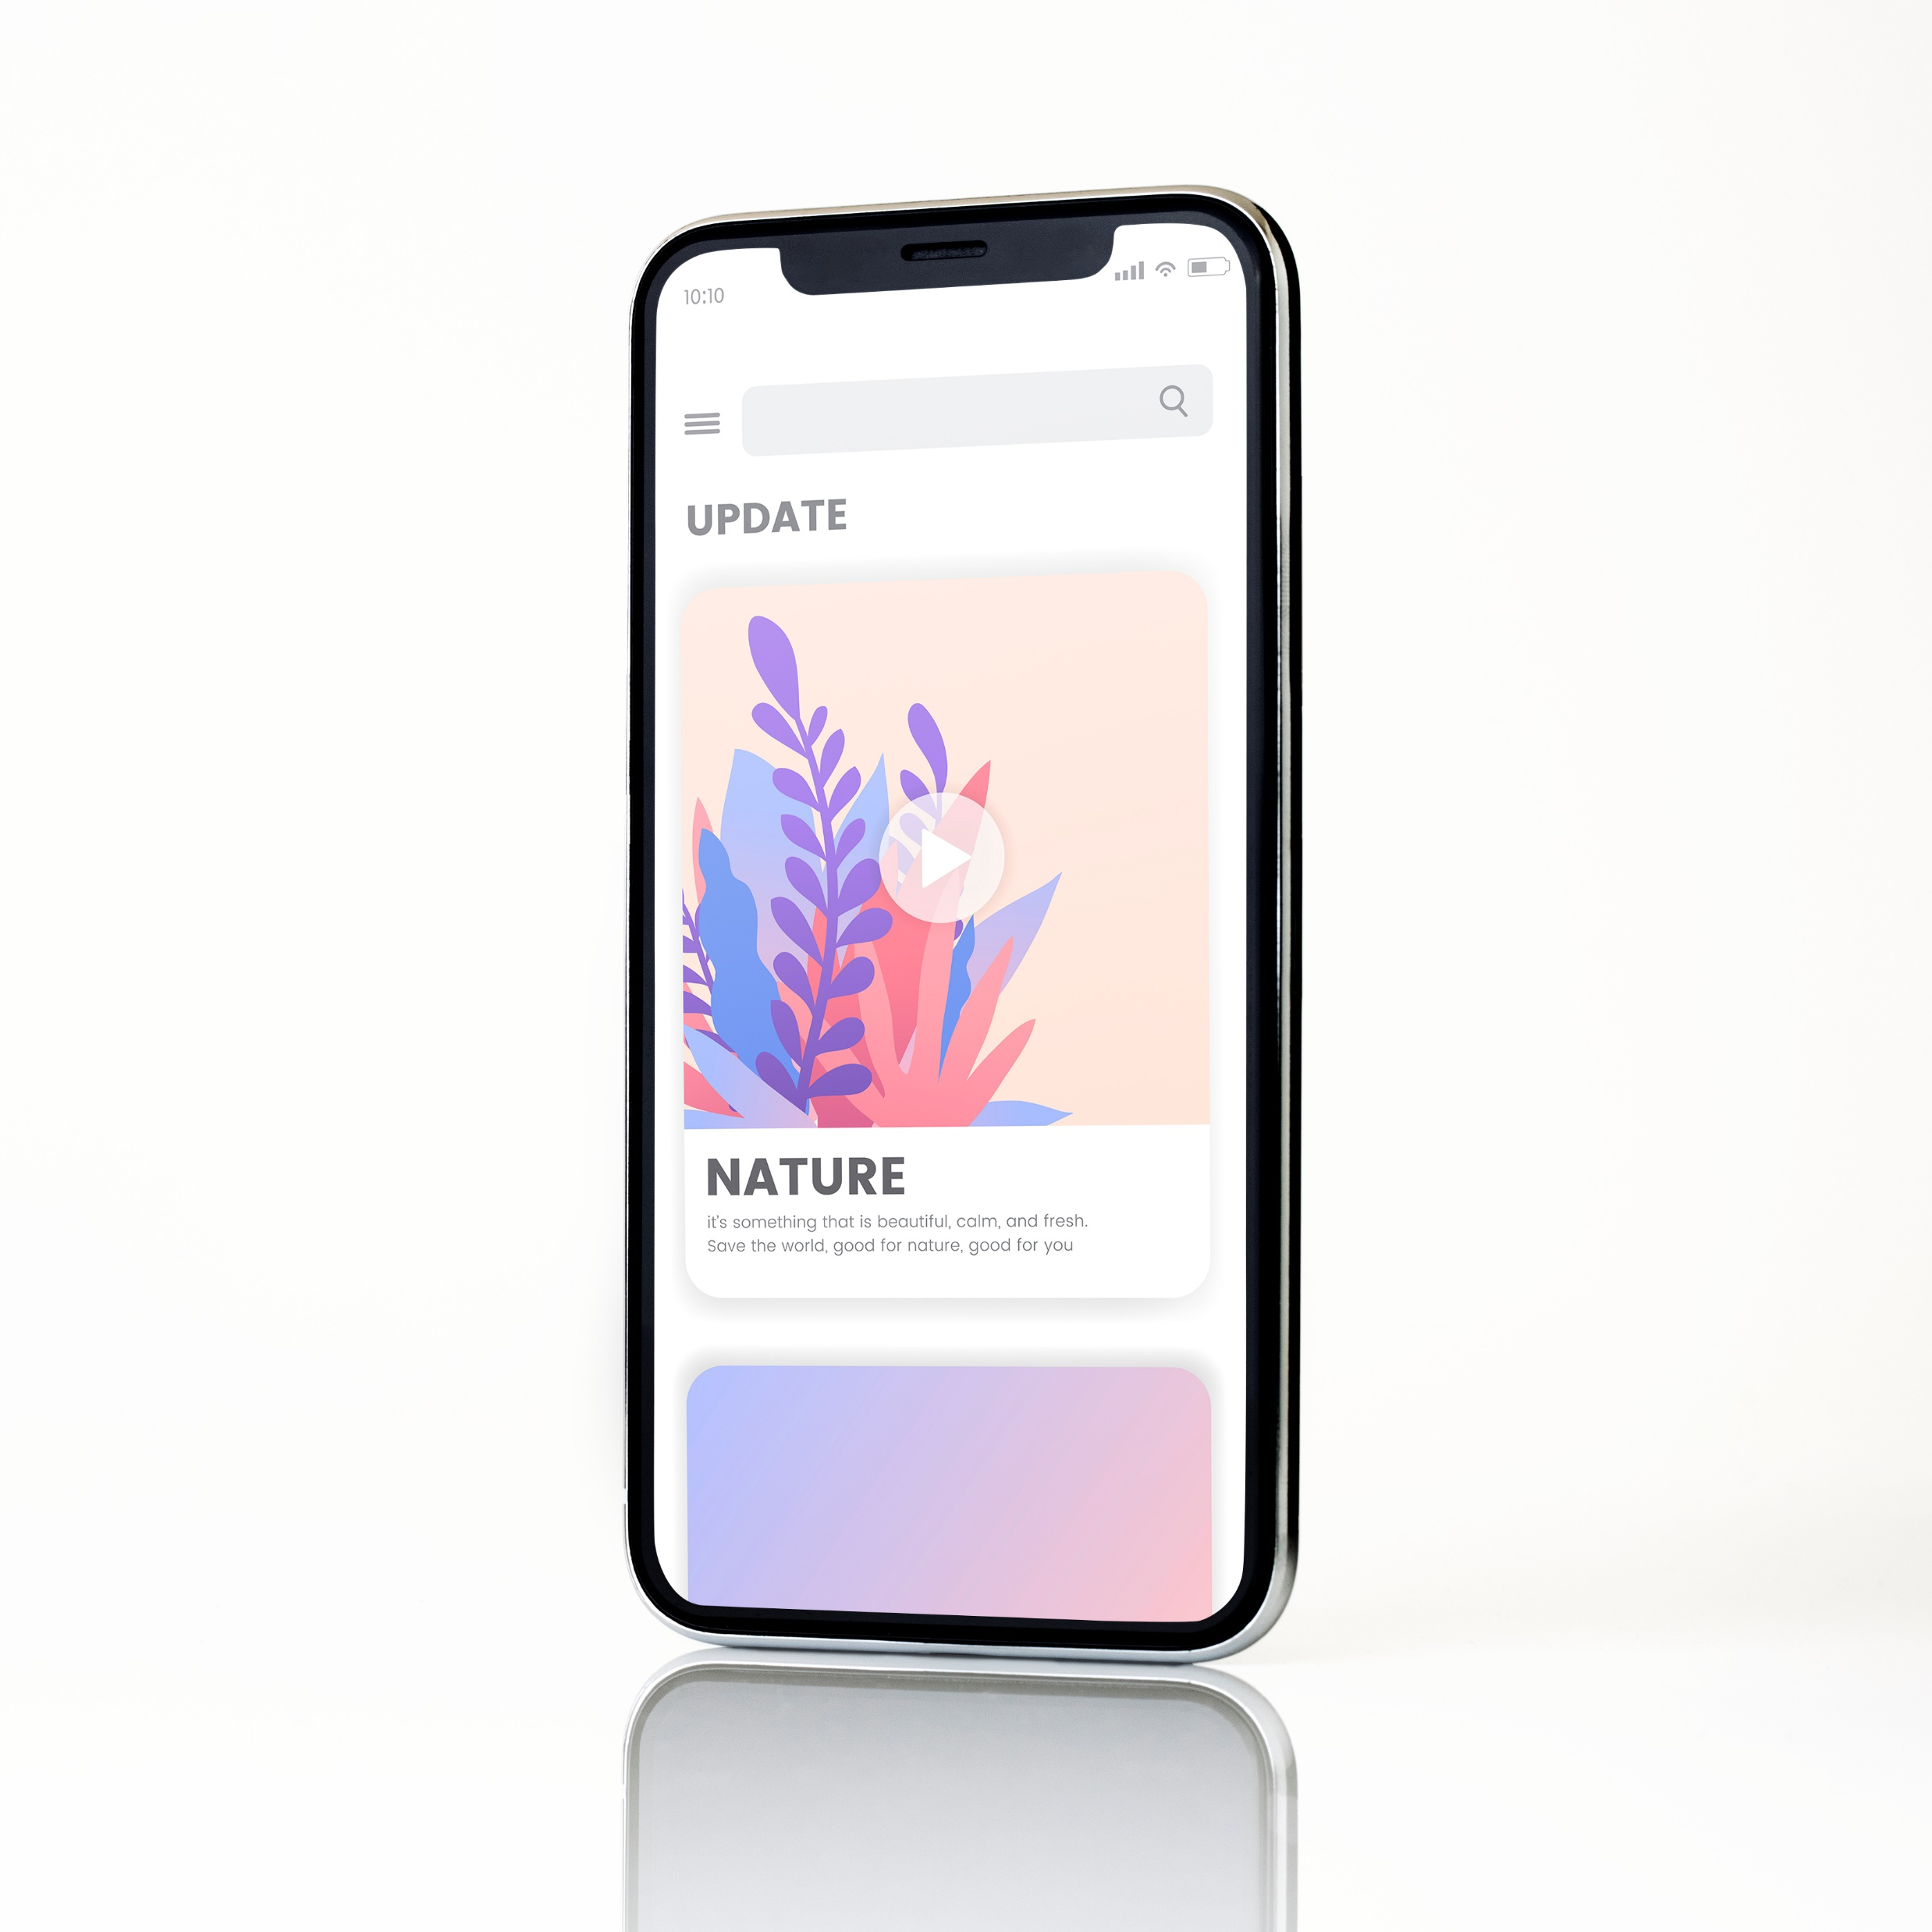
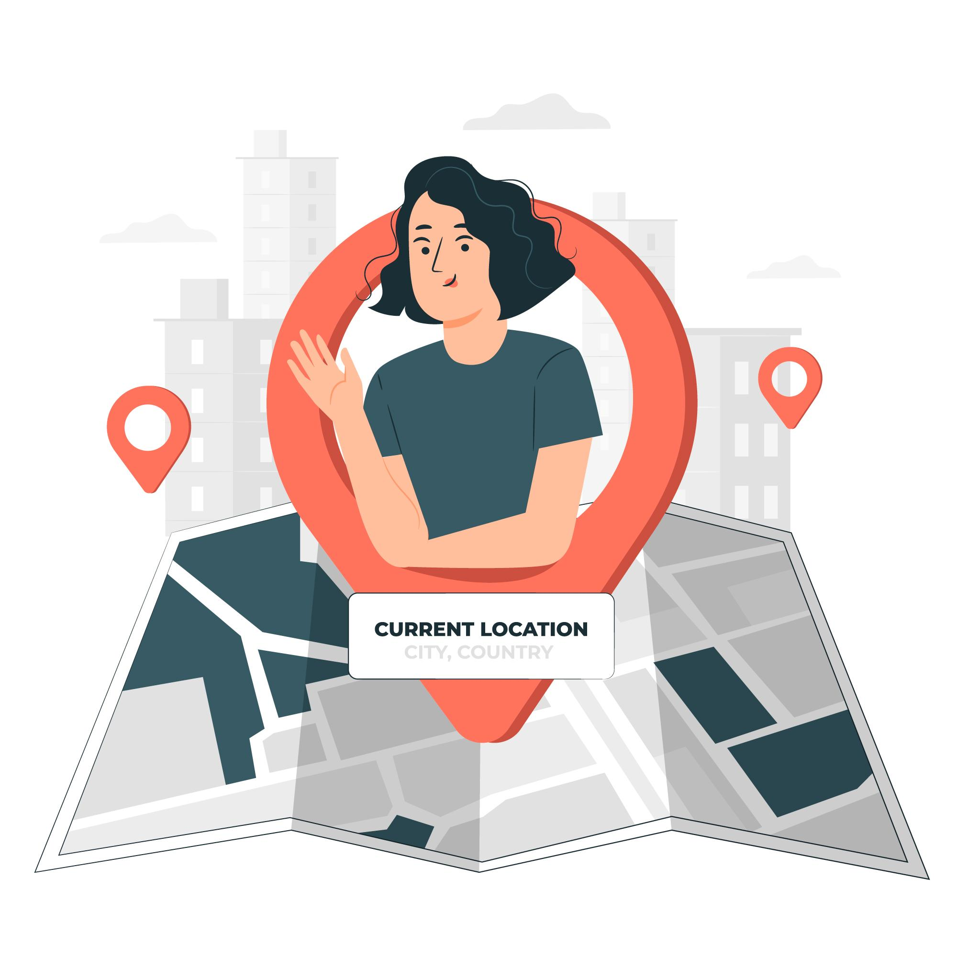


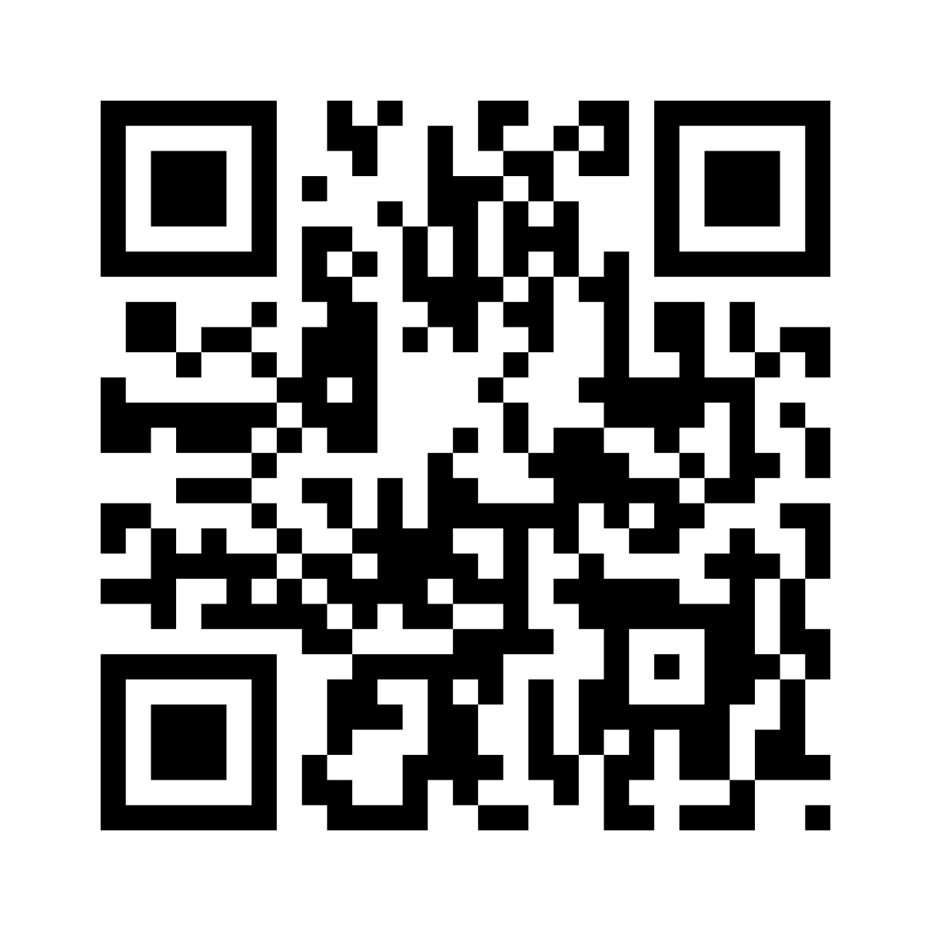

Design of the application
Creating the travel story step by step.
Service providers dashboards
Mr. John
Leisure Diary
Mobile App
Leisure activity
Leisure Diary
Admin / DB
Make a request
Accommodation
Send the request
Check posts
Post
Travel plan approved,
Share the plan through
QR
Request confirmation
Get confirmation
Transport
John is a traveler,
He need to travel to Galle on 1st of January to do surfing and eat best sea food in the town.
John prefers to travel in a car and his whole budget for the trip would be Rs. 100,000
Other features
Geo map
Connect features through API
Trip plan sharing
Service providers can send promotions
Food
Leisure Diary

Slide 9

Methodology
Waterfall Model
Requirement gathering from travelers & SP
Creating UI/UX
Implementation of the Application
Testing the implemented application
Deployment of the application
Maintenance
Leisure Diary

Slide 10







Technologies & Resources
A mobile application - Travelers
Admin panel - Leisure Diary admin.
Admin panels – each service providers.
Connect everyone through rest API
Technologies to be used
Leisure Diary

Slide 11
Conclusion
As the solution involves many stakeholders the company has decided to propose them the solution and to negotiate the contract while the solution is being implemented. Also, the company has planned to promote the application to attract the clients. The application is aimed to be a hassle free solution provided to the travelers and related parties.
Leisure Diary

Slide 12


Thank You

Slide 13
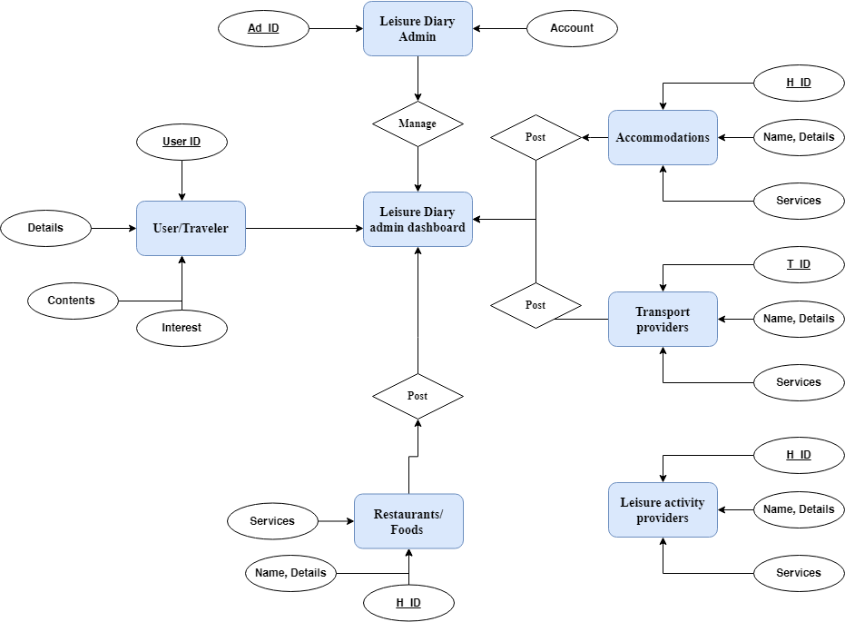
References
ER

